Slide 1



Jal Drishti
Smart Rural Water Quality and Distribution Monitor
Presented by
Mentors
Group 27
Neha Zanjad | Vishnu Vardhan
Sampurna Raychaudhuri | Yarragorla Sri Harshitha | Monica M | N Deekshitha | Arushi Katiyar
WiSH134 | WiSH135 | WiSH136 | WiSH137 | WiSH138

Slide 2





Empathise
OBSERVED REALITIES
  Sewage contaminated tap water
  Irregular municipal water supply
  Widespread untreated water
consumption

Slide 3




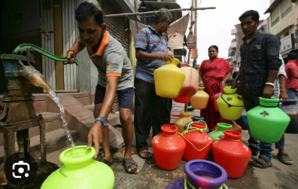
Water Quality Monitoring
  Difficult to detect pathogen contamination.
  Risk to safe drinking water supply.
  Lack of continuous water quality monitoring.
Defining the problem
Water Distribution Monitoring
The solution must be low-cost, scalable, and easily deployable within existing rural water networks while providing real-time monitoring and alerts.
  Uneven water distribution in rural networks.
  Tail-end households face water shortages.
  Poor distribution affects supply reliability.

Slide 4




Ideate
  Lack of real-time water quality monitoring in rural pipelines.
  No early warning mechanism for contamination.
  Unequal water distribution across households.
Used feedback for iterative refinement and proactive problem solving
Challenges
Brainstorm
Feedback
Concept Sketches
Final Idea
Generate real-time alerts for contamination events.
Monitor parameters such as turbidity, pH, residual chlorine, and flow rate.
Deploy low-cost water quality sensor nodes at source, storage tanks, and distribution points.
Use solar-powered IoT devices for autonomous operation.
Track flow and pressure data to identify unequal distribution and leakages.
Provide a dashboard or simple mobile/SMS notifications for authorities.
Transmit data wirelessly to a centralized monitoring platform.

Slide 5
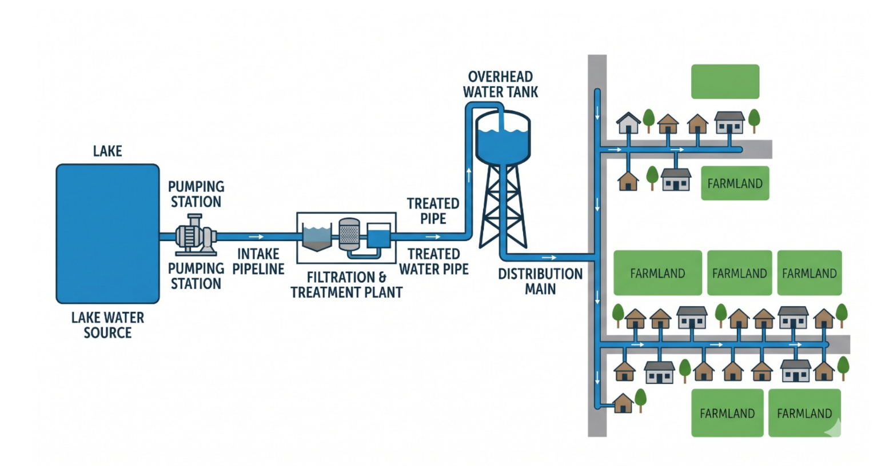
OVERVIEW
GATEWAY NODE
NODE 2
NODE 1
NODE 3

Slide 6
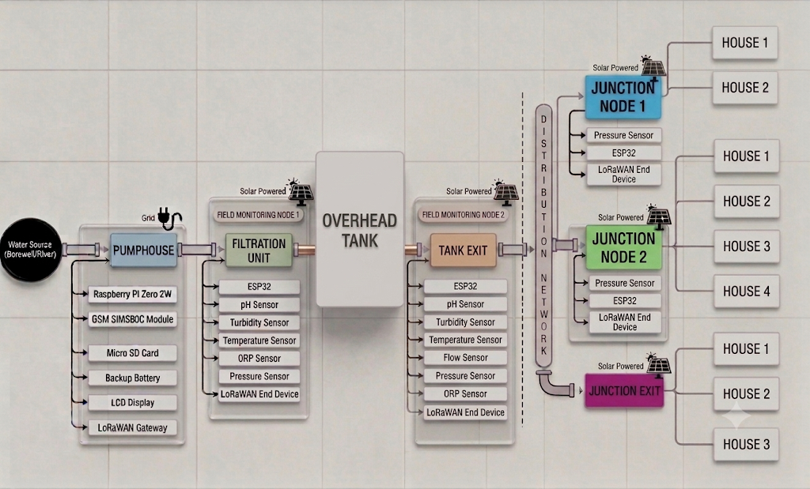

PROPOSED SOLUTION
Water Source
(river)

Slide 7


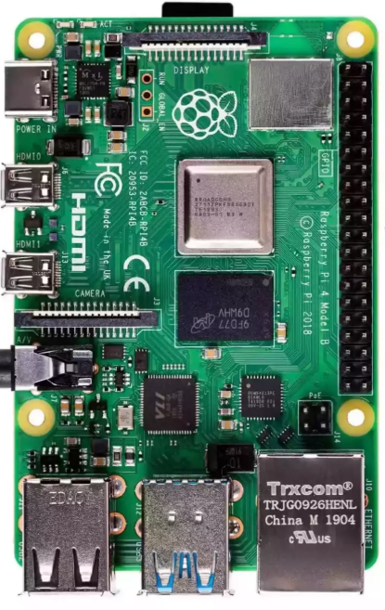


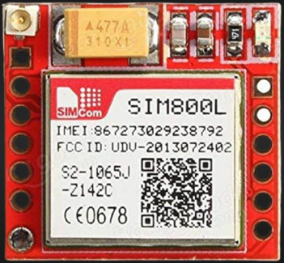

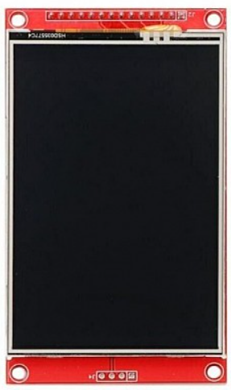
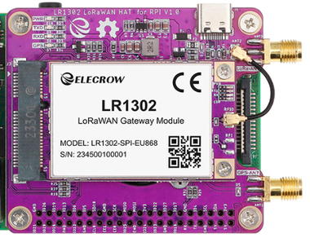

GATEWAY NODE
MICROSD CARD
Why did we choose grid power over solar power for RPi?
+5V
GRID POWER
RASPBERRY PI 4
GSM Sim800L
+5V
BACKUP BATTERY
FROM SENSOR NODES
LORAWAN SX1302
LCD DISPLAY SCREEN

Slide 8
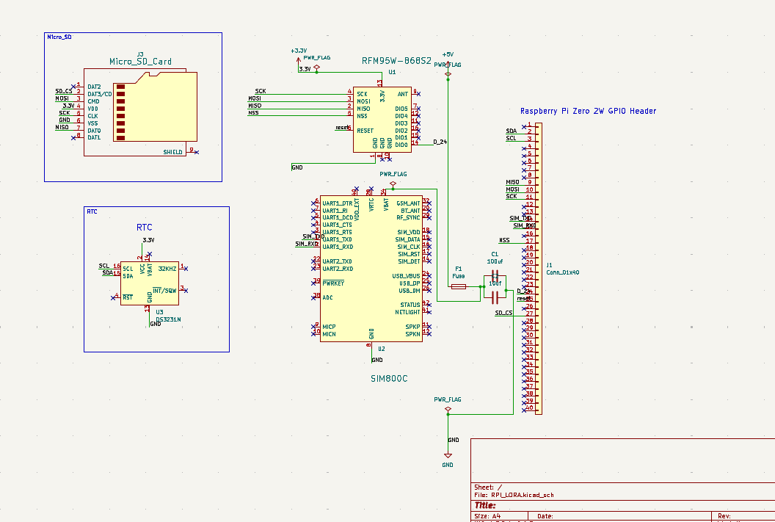
S
C
H
E
M
A
T
I
C

Slide 9

FIELD MONITORING NODE 1
Water Source
(river)

Slide 10
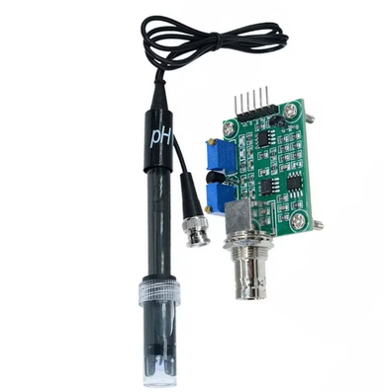
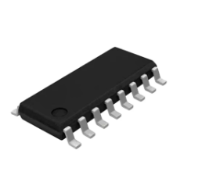
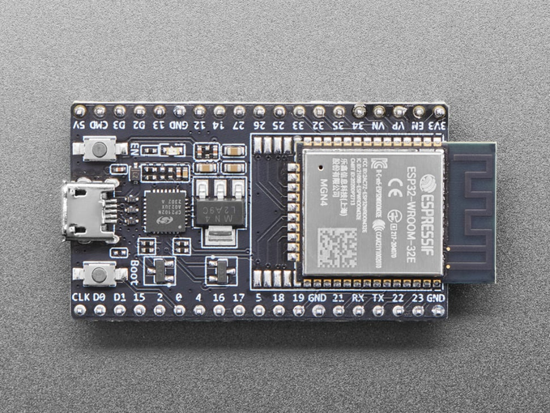
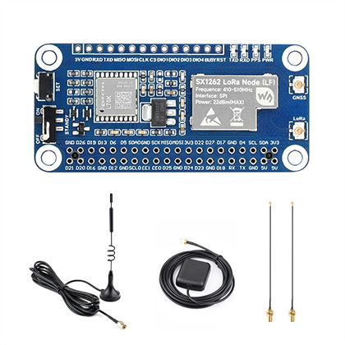
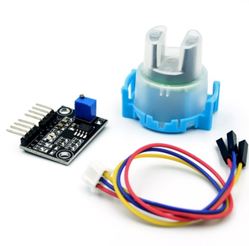
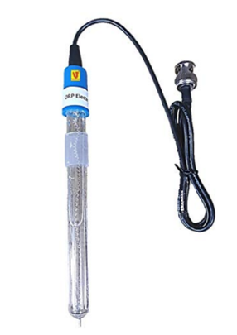
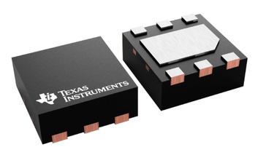
FIELD MONITORING NODE 1
SOLAR POWER
PH PROBE
+5V
TP4056
ESP 32
LORAWAN
LiPO BATTERY
24 BIT ADC
TURBIDITY
BOOST CONVERTER
SENSOR ARRAY
ORP ELECTRODE
Temperature sensor

Slide 11
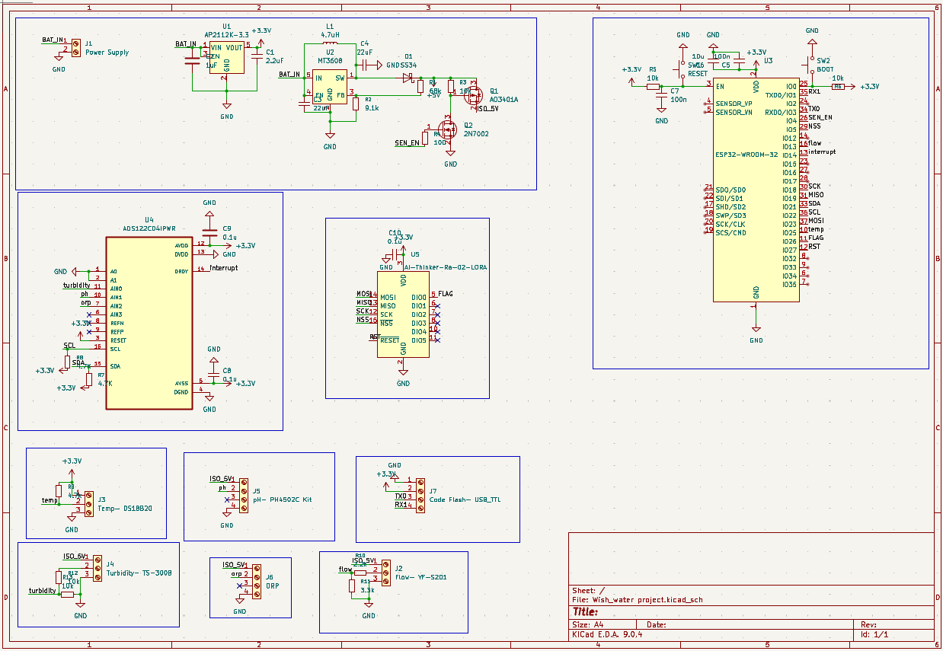
S
C
H
E
M
A
T
I
C

Slide 12
OVERHEAD TANK
FIELD MONITORING NODE 1
FIELD MONITORING NODE 2
Water Source
(river)

Slide 13
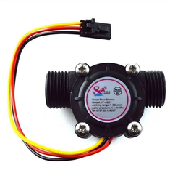
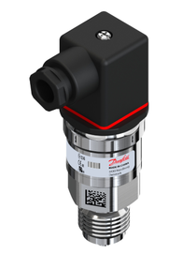
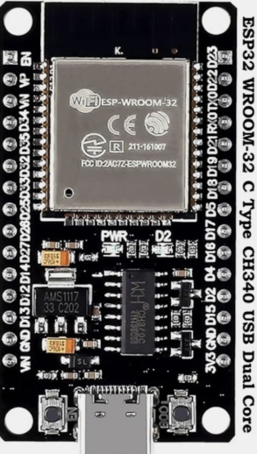
FIELD MONITORING NODE 2
SOLAR POWER
PRESSURE TRANSMITTER
Flow sensor
LORAWAN SX1286
SENSOR
ARRAY
Ph PROBE
TP4056
LiPO BATTERY
TURBIDITY
24 BIT ADC
TI BOOST CONVERTER
ESP 32
ORP ELECTRODE
+5V
Temperature sensor

Slide 14
OVERHEAD TANK
FIELD MONITORING NODE 1
FIELD MONITORING NODE 2
Water Source
(river)

Slide 15


JUNCTION NODE
SOLAR POWER
TP4056
PRESSURE TRANSMITTER
24 BIT ADC
LiPO BATTERY
BOOST CONVERTER
+5V
SENSOR ARRAY
ESP 32
Connecting houses with same pressure
LORAWAN SX1286

Slide 16
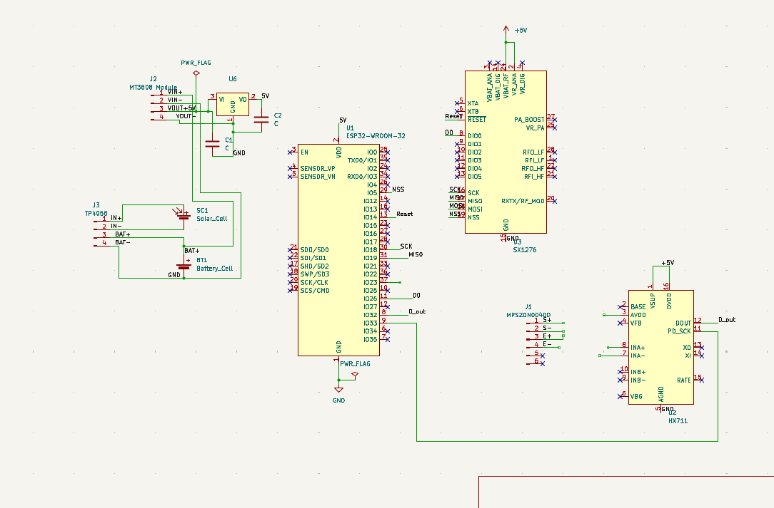
S
C
H
E
M
A
T
I
C

Slide 17
OVERHEAD TANK
FIELD MONITORING NODE 1
FIELD MONITORING NODE 2
Water Source
(river)

Slide 18
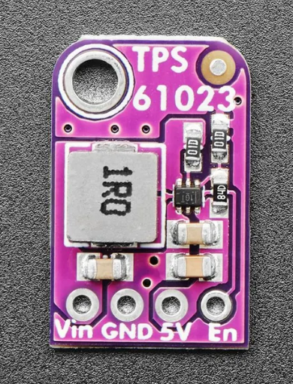
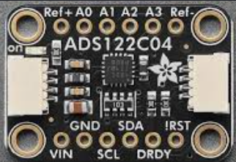
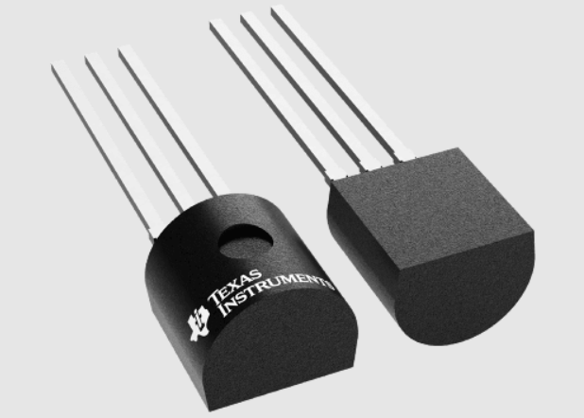
TI COMPONENTS USED
ADS122C04 24-bit ADC
chip module
TI TPS61023 Boost Converter
TI LM35DZ Temperature Sensor
  High 24 bit Resolution Precision
  built-in low-noise PGA
  Achieves up to 94% power
conversion efficiency
  Allows for Ultra-Low Input
Voltage (0.5V)
  Direct Celsius Calibration
  Draws only 60 µA, Minimal Self-Heating

Slide 19









Distribution Parity Check
Water Quality Diagnostics
Intermittent Supply
  Checks turbidity, pH, chlorine, and E. coli
  Any threshold breach triggers an immediate SMS alert to the operator
  Track the water volume between OHT node and junction node against a calculated threshold
  Threshold accounts for the exact no of houses connected to a junction
  Monitors Supply Windows
  Can differentiate between non supply window and actual issue
  Saves Power through deep sleep mode during scheduled non supply window
HYBRID ARCHITECTURE
Leakage & Blockage Detection
Core features
  Integrates distributed end-node hardware with localized edge gateway
  Delivers immediate on-site fail-safe actions alongside a high-level central network
  Identifies a burst when the flow rate difference between 2 nodes drops by more than 15%
  Detects blockage if water from OHT fails to reach junction node 10 mins
Post-Filtration Isolation
SCALABILITY
Post-Supply Leakage & Flushing
  Node1 placed directlly after filtration tank as a critical fail safe
  Catch filtration failures instantly before water reaches storage
  The solution can be expanded to any number of houses
  Thus, the solution is independent of the number of junction nodes and the size of the village
  Detects zero pipeline pressure
during off hours
  Prevents contaminated water from being sucked into cracks via vacuums
  Executes a 2-minute pipeline flush to
clear next supply cycle

Slide 20
PROTOTYPE
GATEWAY NODE
NODE 2
NODE 1
NODE 3

Slide 21

NODE 1
COST ESTIMATION
GATEWAY
NODE BASE COST | ₹3000
Water Turbidity Sensor | ₹700
Liquid pH Sensor | ₹900
ORP Sensor | ₹7000
TI LM35DZ Temperature Sensor | ₹250
SUB - TOTAL | ₹11850
  Raspberry Pi 4 (4GB RAM): ₹7,000
  5V 3A AC-to-DC Adapter: ₹600
  LoRaWAN Multi channel SPI Concentrator Shield (SX1302): ₹7,500
  32GB High-Endurance MicroSD Card: ₹1,400
  GSM Sim800L Module: ₹300
  Antenna: ₹300
  3.5 Inch TFT Touch Screen Display: ₹1,150
  Backup battery 20000 mAh battery - ₹1300
NODE 3
NODE BASE COST | ₹3000
PRESSURE TRANSMITTER | ₹1000
SUB - TOTAL | ₹4000
TOTAL COST FOR NODES
= ₹(11850+12850+4000)
= ₹28700
NODE 2
TOTAL COST FOR GATEWAY : ₹19550
NODE BASE COST | ₹3000
QUALITY SENSORS SAME AS NODE 1 | ₹8850
PRESSURE TRANSMITTER | ₹1000
SUB - TOTAL | ₹12850
TOTAL: ₹ (19550 + 28700)
₹ 48250

Slide 22
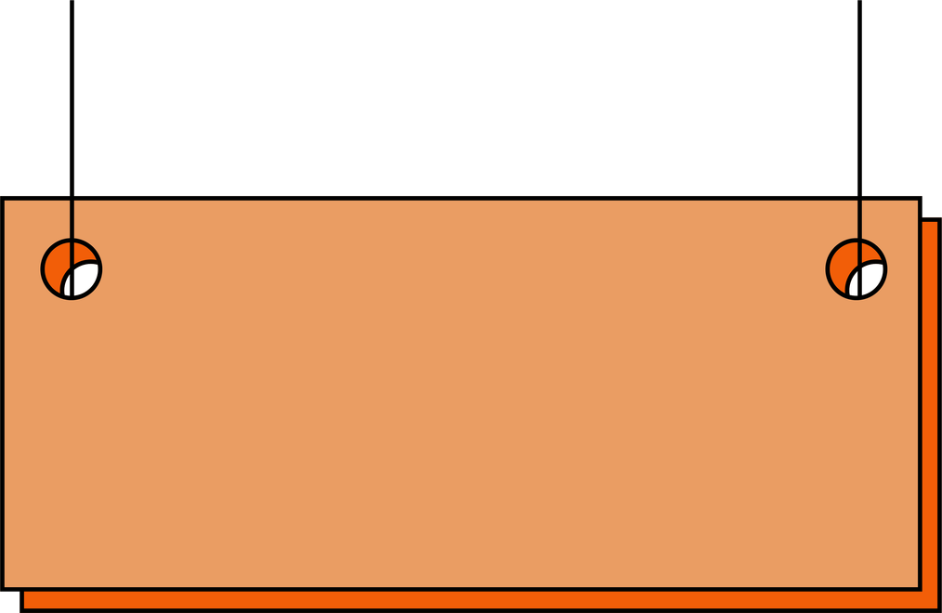



FUTURE SCOPE
Closed-loop mitigation
Multi-sensor integration
Open data architecture
Upgrading from open-loop alerts to an autonomous system where RPi controlled solenoid valves instantly isolate contamination lines before distribution
Expanding the sensor array to include Total Dissolved Solids (TDS) and Electrical Conductivity (EC) parameters etc for a more thorough and robust analysis
Streaming real time water quality metrics to a public cloud dashboard to foster municipal oversight and community transparency

Slide 23




RASPBERRY PI 4
GATEWAY PROCESSING FLOW
Receive sensor data from multiple LoRaWAN end nodes.
.
Decode and extract water quality parameters.
WHY RPI?
Provides sufficient processing power for:
  Multi-node data handling
  Threshold analysis
  Alert generation
  Data logging
  Peripheral control (LCD, GSM, microSD)
ORP
Calculates:
pH
Chlorine,
ORP
Ecoli
Temp
Compare readings against predefined threshold values.
Generate alerts when abnormal conditions are detected.
The SX1302 LoRaWAN concentrator requires a Linux-based operating system for multi node communication.
Send SMS notifications via GSM module.
Store historical data on microSD card.
Update LCD display when requested (Wake-on-Demand)

Slide 24

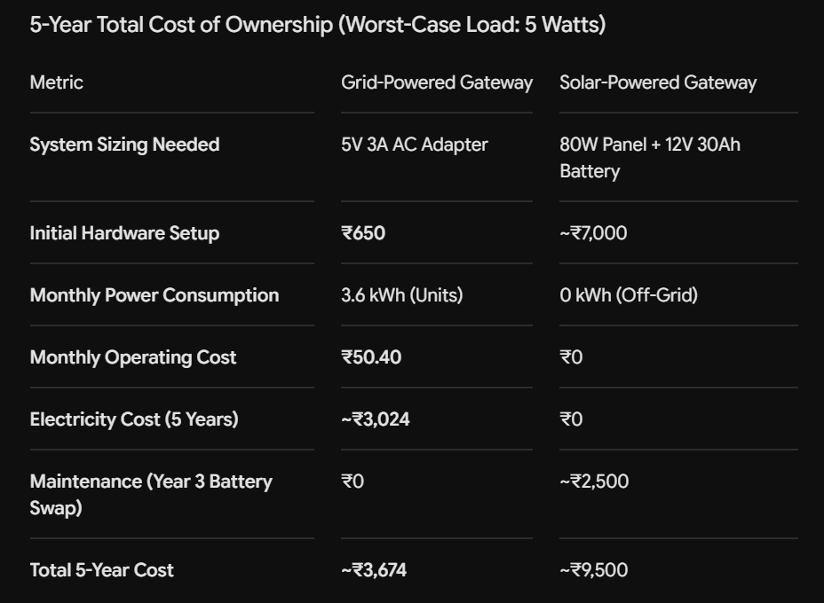
WHY IS IT BETTER TO USE GRID POWER OVER SOLAR POWER FOR THE MAIN GATEWAY?
Unlike an ESP32, RPI consumes 5W in worst case scenario due to the extensive processing and the lack of a deep sleep state.
A grid-powered gateway is more cost-effective over 5 years, costing roughly 61% less than the total investment required for a solar-powered system.
GRID POWER>>>>> SOLAR POWER
For the RPi Gateway

Slide 25


Deep sleep
  Asleep for 99%
  power consumption reduced by 95-99%
Why are Esp32s solar powered??
via LoRa
  Esp32 reads sensors
Raspberry Pi
  Esp32 wakes up
  Deep sleep mode
Active mode: 80-240mA
Deep sleep: 5-150uA

Slide 26
CORE NODE BASE COST
  Solar Panel (10W,6V): ₹600
  TP4056 Charging Module: ₹40
  18650 Li-ion Cell: ₹200
  TI TPS61023 Boost Converter: ₹60
  ESP32: ₹300
  LoRa Transceiver (SX1276): ₹400
  IP65 Waterproof Junction Box +
Glands: ₹250
  Antenna- ₹150
  TI ADS122C04 24-bit ADC Chip
Module - ₹1000
JUSTIFIED AS
  Operating cost: near-zero
  Limited running cost with
1. Minor battery replacement cost 2.Periodic sensor calibration cost
  No manpower/sampling cost
  Low scaling marginal cost because of
shared architecture
SUB-TOTAL: ₹3000/node

Slide 27





CORE OPERATIONAL CAPABILITIES
WATER QUALITY DIAGNOSTICS
LEAKAGE DETECTION
INTERMITTENT SUPPLY MONITORING AND PIPE BLOCKAGE MONITORING
NON SUPPLY LEAKAGE & FLUSH MANAGEMENT
DISTRIBUTION PARITY CHECK
CHECKS TURBIDITY, PH, CHLORINE & E.COLI AT FILTRATION OUTPUT AND OHT END
THRESHOLD BREACH → SMS ALERT TO OPERATOR PROMPTING TO SHUTDOWN OF PUMP/VALVE.
Efficiency Ratio = (Vnode3/Vnode2) × 100, where V = Σ(Q×Δt)
Threshold_min =
100% − [β + (N×α)]
N = houses fed, α = 0.8%/house, β = 5% fixed loss
Ratio < Threshold → SMS alert (unequal distribution)
Flags a main-line burst when ΔQ > 15% of Qnode2 for over 60 seconds
ΔQ=Qnode2 − Qnode3
Alert if ΔQ>0.15×Qnode2
for >60s (filters noise/surges) → SMS MAIN_LINE_BURST with junction location
Tracks supply windows
In-window:
Qnode2>0 & Qnode3=0 for 10 min → BLOCKAGE
Off-window:
Qnode2=0 & Qnode3=0 → no alert, deep sleep mode
Detects prolonged zero-pressure (>2 hrs) during off-hours that risks contaminant ingress at joints/cracks
→ SMS alert +
2 min flush before next cycle
1
2
3
4
5

